Slide 1
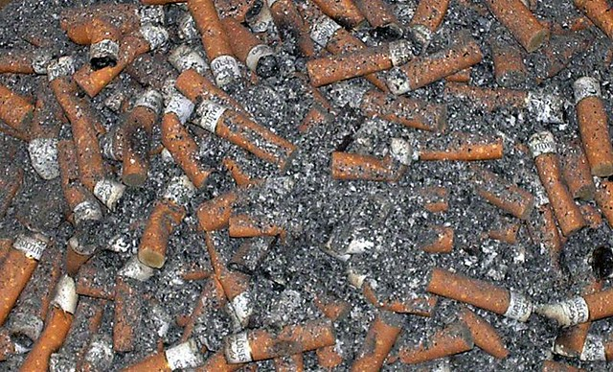
Cigarette Project
Leson 10 Hands On
Ruben Larrazolo

Slide 2
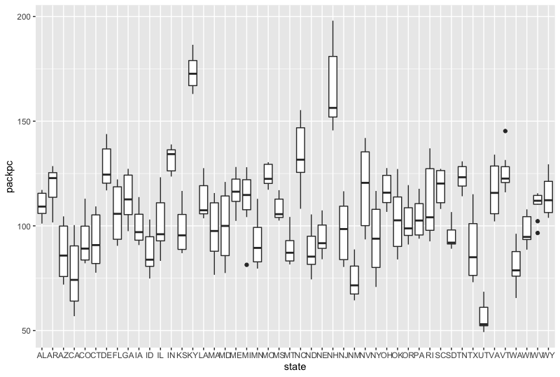
Cigarette Project
the average number of packs per capita by state

Slide 3
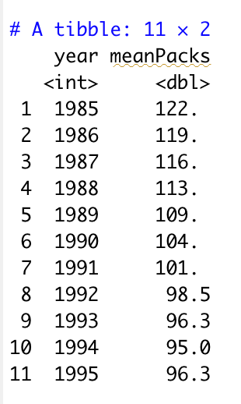
21.0656% decrease
the median over all the states of the number of packs per capita for each year

Slide 4
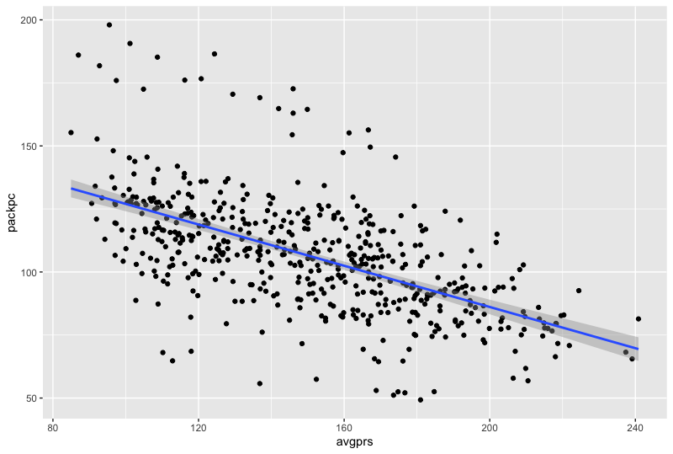
The usage of cigarettes desecrate 21.0656% during the 11 year period

Slide 5
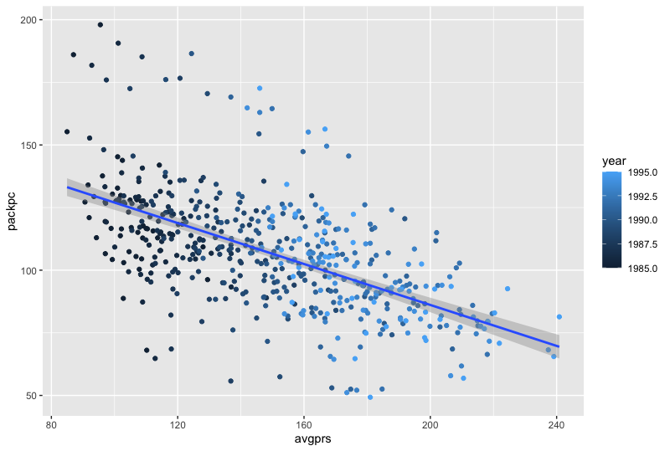
The correlation of this hypothesis is negative correlated since the usage of cigarettes decrease 21%

Slide 6
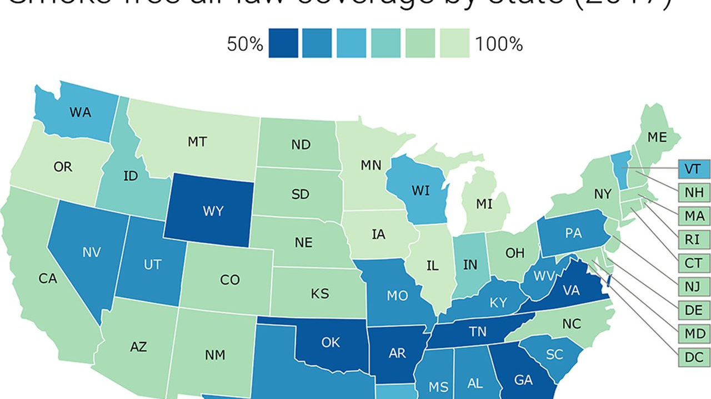
Residuals:
Min 1Q Median 3Q Max
-56.566 -13.853 -2.646 10.701 80.819
Coefficients:
Estimate Std. Error t value Pr(>|t|)
(Intercept) 5927.5923 580.8610 10.21 <2e-16 ***
year -2.9252 0.2919 -10.02 <2e-16 ***
---
Signif. codes: 0 ‘***’ 0.001 ‘**’ 0.01 ‘*’ 0.05 ‘.’ 0.1 ‘ ’ 1
Residual standard error: 21.21 on 526 degrees of freedom
Multiple R-squared: 0.1603, Adjusted R-squared: 0.1587
F-statistic: 100.4 on 1 and 526 DF, p-value: < 2.2e-16
linear regression for these two variables.

Slide 7
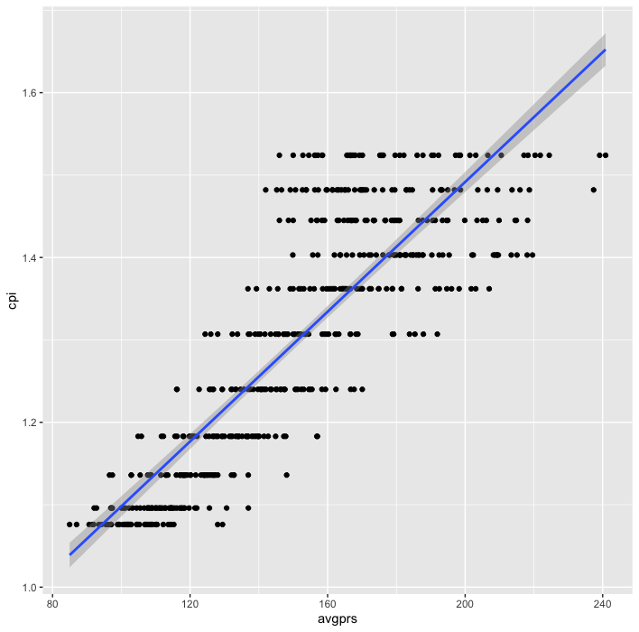
Adjust for Inflation

